Slide 1




















































Prevent Cheating in online exam
Nikhil Verma | --- | 301402218147
Nitin Kumar Ramteke | --- | 301402218154
Pranav Agrawal | --- | 301402218151
Vishal Singh | --- | 301402218155
Guide | --- | Dr. Abha Choubey

Slide 2
Problem statement:-
How to prevent cheating in online exam?

Slide 3
Solution :-
Eye movement tracking system & face-recognition
In this project we are proposing a program in PYTHON to identify and track the eye ball movement.
To detect whether the student is looking away from the screen or not and face-recognition

Slide 4
WHAT IS EYE TRACKING:-
Process of measuring where we look, also known as our point of gaze. These measurements are carried out by an eye tracker.
Eye tracker, that records the position of the eyes and the movements they make.

Slide 5





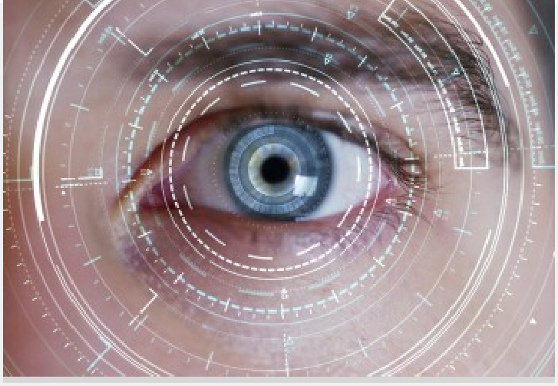

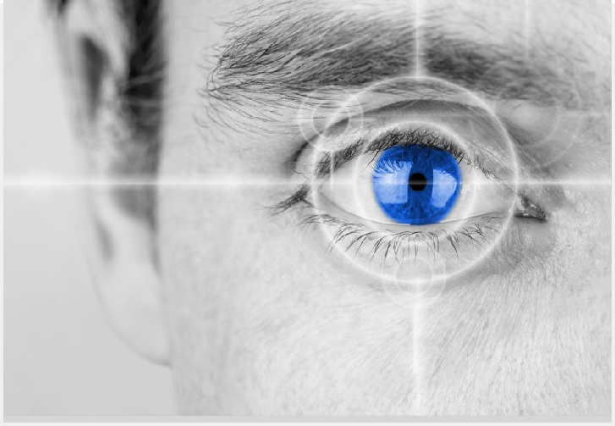








WORKING (eye movement) :-
Our three-phase feature-based eye gaze tracking approach uses eye features and head pose information to enhance the accuracy
of the gaze point estimation.
In Phase 1, we extract the eye region that contains the eye movement information. Then, we detect the iris center and eye corner to find the eye coordinates.

Slide 6
WORKING(eye movement):-
Phase 2 obtains the parameters for the mapping function, which describes the relationship between the eye coordinates and the gaze point on the screen. In Phases 1 and 2, a calibration process computes the mapping from the eye coordinates to the coordinates of the monitor screen.
Phase 3 entails the head pose estimation and gaze point mapping. It combines the eye coordinates and head pose information to obtain the gaze point.

Slide 7
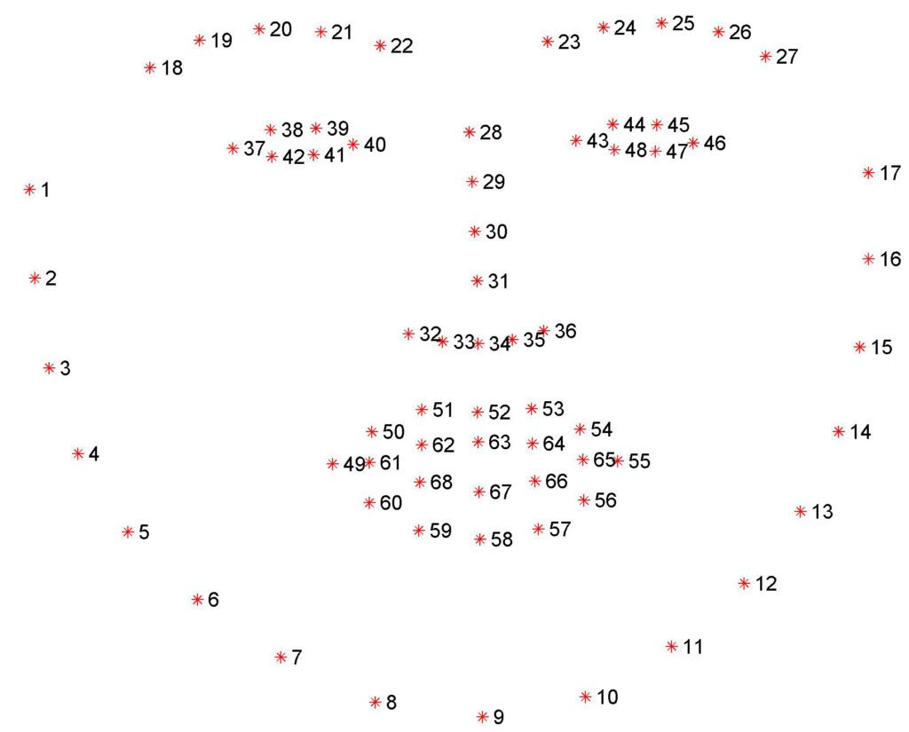
The pre-trained facial landmark detector inside the dlib library is used to estimate the location of 68 (x, y)-coordinates that map to facial structures on the face. The indexes of the 68 coordinates can be visualized on the image below:

Slide 8
Classes used
Gaze tracking:- This class tracks the user's gaze. It provides useful information like the position of the eyes and pupils and allows to know if the eyes are open or closed.
Eye detection:- This class creates a new frame to isolate the eye and initiates the pupil detection.
Pupil detection:- This class detects the iris of an eye and estimates the position of the pupil.
Calibration:- This class calibrates the pupil detection algorithm by finding the best binarization threshold value for the person and the webcam.

Slide 9
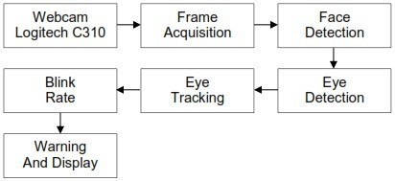
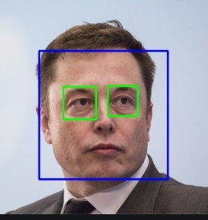
BLOCK DIAGRAM:-

Slide 10
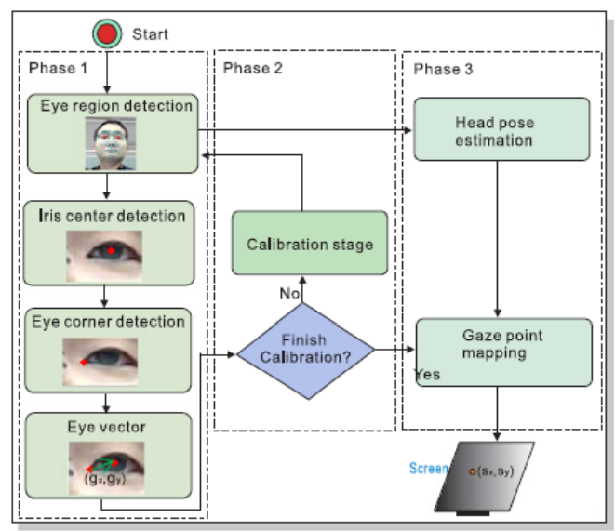
Flow chart

Slide 11
WHAT IS FACE RECOGNITION:-
• Face Recognition System is physical characteristics
recognition technology, using the inherent physiological
features of humans for ID recognition.
• Two Types:-
* Verification- System compares the given
individual with who they say they are and
gives a Yes or No decision.
* Identification- System compares the given
individual to individuals in the database

Slide 12
WORKING(face recognition):-
Phase 1 Detect the face and crop the image to reflect only face .
Phase 2 Convert physical feature of face into mathematical vectors using FACE RECOGNITION algorithms.
Phase 3 Compare the feature of test image to Face database with the help of FACE ENCODING.
Phase 4 Display the detail of recognized person.

Slide 13
Face Encoding:
The face_recognition API generates face encodings for the face found in the images. A face encoding is basically a way to represent the face using a set of 128 computer-generated measurements. Two different pictures of the same person would have similar encoding and two different people would have totally different encoding.

Slide 14
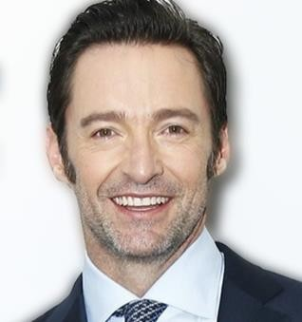
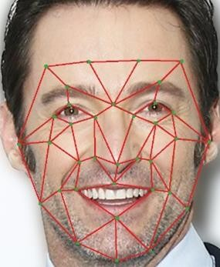
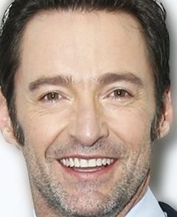
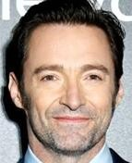














Block diagram :-
WOLVERINE
FACE DETECTION
FACE RECOGNITION
IMAGE
FEATURE EXTRACTION
VERIFICATION/ IDENTIFICATION

Slide 15
Warning and display:-
It displays the coordinates of the eyes.
Which direction eyes are looking i.e. left, right or center.
It also detects blinking of the eyes.
Name of the person if registered otherwise displays unknown

Slide 16

System requirement:-
Windows 7 or above
Webcam
Ram 4gb or above
PyCharm

Slide 17


